Slide 1


MAAER’S MIT COLLEGE OF
ENGINEERING
A Project Based Seminar
On
A Secure Block-Chain Based Electronic Voting System
By:
Pabitra Parida (3154081)
Prasad Pathak (3154084)
Anish Pawar (3154089)
Guide :Prof. Vaishali Suryawanshi

Slide 2
Contents:
Project Topic
Project Details
Project Motivation
Introduction
Seminar Topics : Survey of Blockchain: Potential applications and challenges
Application, challenges
References

Slide 3
Project Details
Project Title : A Secure Block-Chain Based on Electronic Voting System
Project Domain : Distributed Computing
Project Group Members : 1. Pabitra Parida (3154081)
2. Prasad Pathak(3154084)
3. Anish Pawar (3154089)

Slide 4
Project Motivation
Democratic voting is a crucial and serious event in any country.
The most common way in which a country votes is through a paper based system, but is it not time to bring voting into the 21st century of modern technology?
Digital voting is the use of electronic devices, such as voting machines or an internet browser to cast votes.

Slide 5
Problem Statement
To design a next generation secure, transparent, tamper proof voting system built on the foundations of the blockchain.

Slide 6
Aim and Objectives of the Project
Aim
The aim of this project is solving the issues of digital voting by using blockchain technology.
Objectives
To build a secure, transparent , efficient voting system to replace current slow, ineffective voting systems.
The final system should be unbiased and tamper proof.

Slide 7
Project and Seminar Topics
Project Titile : A Secure Block-Chain Based on Electronic Voting System.
Pabitra Parida : Technologies in blockchain.
Prasad Pathak : Survey of Blockchain: Potential applications and challenges.
Anish Pawar : Voting system using Smart Contracts

Slide 8

Survey of Blockchain: Potential applications and challenges
- Prasad A Pathak

Slide 9
Introduction
Blockchain is being termed as the fifth disruptive innovation in computing.
This detailed survey intends to bring together all the key developments so far in terms of putting blockchain to practice.
Although the feature of blockchain technologies may bring us more reliable and convenient services.
The security issues and challenges behind this innovative technique is also an important topic that we need to concern.

Slide 10
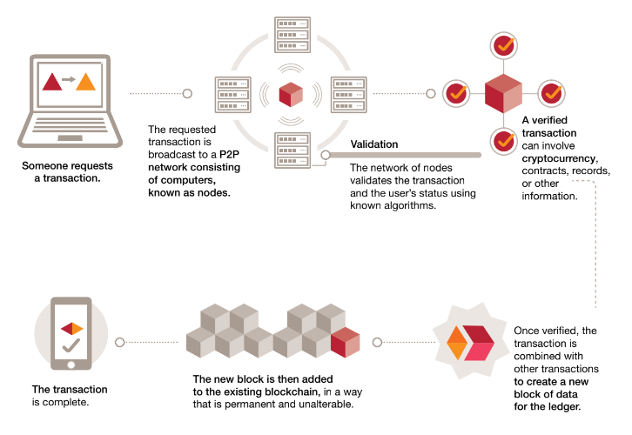
Literature Survey
Working:
The sending node records new data and broad casting to network.
The receiving node checked the message from those data which it received, if the message was correct then it will be stored to a block.
All receiving node in the network execute proof of work (PoW) or proof of stake (PoS) algorithm to the block.
The block will be stored into the chain after executing consensus algorithm, every node in the network admit this block and will continuously extend the chain base on this block.

Slide 11
Blockchain Protocols
Blockchain eliminates the need for third party to conduct transactions on one’s behalf.
This implies that the consensus mechanism has to exist in the network itself.
How a given blockchain network implements its consensus mechanism, determines the strength of the network.
A foolproof consensus mechanism, suitable for purpose (of the blockchain in question) is essential to maintain sanity and coherence of data among the participating nodes of the network.

Slide 12
Types of Protocols
Proof of Work :
PoW protocol requires all nodes on the network to solve cryptographic puzzles by brute force.
For example, in case of Bitcoin blockchain, the new transactions are tentatively committed and then based on the PoW output, a selected block created by the winning node is broadcast to all the nodes, at specific synchronization intervals.
Proof of Stake :
Proof of stake protocol of block verification does not rely on excessive computations.
Instead of splitting blocks across proportionally to the relative hash rates of miners (i.e. their mining power), proof-of-stake protocols split stake blocks proportionally to the current wealth of miners.

Slide 13
Literature Survey/Related work
Sr. No | Reference Name | Seed Idea/ Work Description | Problems found
1. | Blockchain and Its Applications – A Detailed Survey, International Journal of Computer Applications (0975 – 8887) Volume 180 – No.3, December 2017 | A basic survey which includes the introduction, protocols, applications | Major challenges like scalability and regulation are not mentioned.
2. | Reinforcing the links of the blockchain, IEEE Future Directions Blockchain initiative white paper, November 2017 | Applications and challenges are mentioned in detail. | Basic concepts of blockchain like structure and protocols are not explained.
3. | A Survey of Blockchain Security Issues and Challenges, International Journal of Network Security, Vol.19, No.5, PP.653-659, Sept. 2017 | All the protocols and challenges of blockchain are mentioned in detail. | Applications of blockchain in various sectors are not mentioned.
4. | Blockchain Challenges and Opportunities: A Survey, International Journal of Web and Grid Services, December 2017 | A brief study about various aspects of the blockchain technology. | High level language used which is difficult to interpret for beginners.
5. | Blockchain in public sector, Federation of Indian Chambers of Commerce & Industry, January 2018 | Possible use cases of blockchain in public sector. | Research is not focused on core Indian industries.

Slide 14






Applications
Healthcare
Education
Public Safety and Justice
Agriculture
Civil Registration
Supply Chain

Slide 15






Applications
Defense
Governance
Energy
Finance
Identity
Internet of Things

Slide 16
Challenges
Scaling
Security and Reliability
Accessibility
Regulation

Slide 17
Conclusion
In a plethora of blockchain based applications and experiments, faith on the longevity of blockchain technology, is increasing.
Scalability and consensus algorithms are areas of growing research in order to make blockchain more adaptable for businesses of larger scale.

Slide 18
References
Journal article - Supriya Thakur Aras. “Blockchain and Its Applications – A Detailed Survey”, International Journal of Computer Applications (0975 – 8887), Volume 180, No.3, December 2017
Journal article - Iuon-Chang Lin. “A Survey of Blockchain Security Issues and Challenges”, International Journal of Network Security, Vol.19, No.5, PP.653-659, Sept. 2017
Journal article - Zibin Zheng. “Blockchain Challenges and Opportunities: A Survey”, International Journal of Web and Grid Services, December 2017
White Paper – Morgen Peck, “Reinforcing the links of blockchain”, IEEE Future Directions Blockchain Initiative White Paper, November 2017
Study – “Blockchain: The next innovation to make our cities smarter”, Federation of Indian Chambers of Commerce and Industry, January 16, 2018

Slide 19
References
Study – Nikolas Roby. “Application of Blockchain technology in online voting”, University of Maryland University College, 2017
Journal Article – Ahmed Ben Ayed. “A Conceptual Secure Blockchain based electronic voting system”, International Journal of Network Security & Its Applications (IJNSA) Vol.9, No.3, May 2017
Study – Yi Liu and Qi Wang . “An E-voting Protocol Based on Blockchain”, Southern University of Science and Technology, Shenzhen, China
Study – Ivo Kubjas. “Using blockchain for enabling internet voting”, January 6, 2017
Article – Phillip Bouche. “What if blockchain revolutionized voting”, European Parliamentary Research Service, Scientific Foresight Unit (STOA), September 2016-PE 581.918
Study - Binaifer Karanjia. “Blockchain in public sector”, January 2018, Federation of Indian Chambers of Commerce and Industry

Slide 20
THANK YOU

